Slide 1

Łukasz Pyrzyk
@lukaszpyrzyk

Slide 2



About me
Co-founder of Dotnetos
Microsoft MVP
.NET Technical Lead at Sonova
Tweets as @lukaszpyrzyk
@lukaszpyrzyk / Sonova

Slide 3
Agenda
About WebRTC
Signalling
WebRTC internals, SDP, NAT, ICE, STUN, TURN
Demo
War stories
@lukaszpyrzyk / Sonova

Slide 4
Disclaimer
The things we'll talk about today have a lot in common with:
VoIP
online chats
multiplayer games, like FIFA online match making
streaming, like XBox Cloud
RFC (Request for Comments) are fun to read!
@lukaszpyrzyk / Sonova

Slide 5
WebRTC
Web Real-Time Communication
Free and open-source project providing web & mobile APIs for real-time communication
supports video, voice, and text or bytes to be sent between peers, allowing developers to build powerful voice- and video-communication solutions
Don’t require any plugins and native apps
Technology is available on all modern browsers as well as on native clients for all major platforms
Supported by Apple, Microsoft, Google, Mozilla, Opera, Vivaldi and Brave
@lukaszpyrzyk / Sonova

Slide 6
WebRTC history
In 2007 Google acquired a company called Marratech, a well-known producer of e-meetings software. Team and its technology were assigned to add audio & video chat to the GMail
In 2010 Google acquired the company Global IP Solutions (GIPS). The company was best known for developing embedded software for real-time communication, components for VoIP, and videoconferencing, including high-quality codecs
In May 2011 Google released an open-source project for real-time communication within a browser, known as WebRTC
In January 2021, the WebRTC 1.0 specification transitioned from Candidate Recommendation to Recommendation
@lukaszpyrzyk / Sonova

Slide 7
API
getUserMedia - used to get access to the camera and the microphone connected to the user device (user computer, smartphone, etc.) from the browser. When getUserMedia() is invoked, the browser asks for permission from the user to use the media inputs (camera or microphone or both) connected to the user's device
RTCPeerConnection - enabled audio/video communication between peers. It performs code handling, communication, security, and bandwidth management
RTCDataChannel – allows bidirectional communication between the peers
@lukaszpyrzyk / Sonova

Slide 8

Signalling
When we create a WebRTC agent, it knows nothing about the other peers. It has no idea who it is going to connect with or what they are going to send. A Signaling functionality performs a call bootstrapping. It is a centralized place that allows peers to exchange messages and „get familiar” with each other
Signaling messages are just structured text messages. WebRTC agent doesn’t care how they are transported.
They are commonly shared via WebSockets, but that is not a requirement. They can be sent even via email or post pigeon.
@lukaszpyrzyk / Sonova

Slide 9
The message format - SDP
WebRTC uses Session Description Protocol (SDP). With this protocol, all WebRTC agents have all information required to establish a valid connection
The protocol is not specific to WebRTC. SDP specification in fact was released long before WebRTC, in 1998. It is described in RFC 4566
WebRTC uses only a subset of the SDP format
The protocol itself is simple to read, however, the complexity comes from understanding all values that WebRTC populates it with.
@lukaszpyrzyk / Sonova

Slide 10
SDP
It is a protocol based on key/value pairs, with a newline after each value
It is similar to the well-known INI file
The Session Description Protocol defines all valid key
A single SDP message contains zero or more Media Descriptors. Media Descriptor usually maps a single stream of data. So if we want to describe 2 video streams and 2 audio streams, SDP would have 4 Media Descriptors
@lukaszpyrzyk / Sonova

Slide 11
SDP - sample
a=hello-world
a=lorem-ipsum
The given SDP has two lines:
First line has key „a” with value „hello-world”
Second line has key „a” with value „lorem-ipsum”
„a” describes atribute property, a simple text field. It is the most commonly used key
@lukaszpyrzyk / Sonova

Slide 12
SDP
WebRTC uses only a few SDP keys described in the JavaScript Session Establishment Protocol (JSEP) described in the RFC 8829
These keys are:
v - Version, should be equal to 0.
o - Origin, contains a unique ID useful for renegotiations.
s - Session Name, should be equal to -.
t - Timing, should be equal to 0 0.
m - Media Description (m=<media> <port> <proto> <fmt> ...), describes the stream
a - Attribute, a free text field.
c - Connection Data, should be equal to IN IP4 0.0.0.0.
@lukaszpyrzyk / Sonova

Slide 13
SDP – media descriptors
v=0
m=audio 4000 RTP/AVP 111
a=rtpmap:111 OPUS/48000/2
m=video 4000 RTP/AVP 96
a=rtpmap:96 VP8/90000
a=my-sdp-value
SDP contains two Media Descriptors:
The audio stream is located on port 4000, with RTP Audio/Video Profile set to 111. Rtpmap property with the value set to Opus codec with 48000Hz and 2 channels (stereo)
The video stream is located on port 4000, with AVP set to 96, with two attributes. Rtpmap is set to VP8 compression format and one additional, custom property
@lukaszpyrzyk / Sonova

Slide 14
SDP – other keys
WebRTC agent uses a few additional SDP attributes, including group, fingerprint:sha-256, setup, mid, ice-ufrag, ice-pwd, rtpmap, fmtp, ssrc, label and candidate.
The most interesting for us will be the Candidate. It is one of the many possible addresses of the WebRTC agent. It is sent over via SDP as follows: a=candidate:foundation 1 udp 2130706431 192.168.1.1 53165 typ host generation 0 a=candidate:foundation 1 udp 1694498815 1.2.3.4 57336 typ srflx raddr 0.0.0.0 rport 57336 generation 0 a=end-of-candidates
@lukaszpyrzyk / Sonova

Slide 15
P2P
WebRTC doesn't use a client/server model. Instead, it establishes a peer-to-peer connection. In this approach, each participant of the call is responsible for arranging the connection.
To achieve that, WebRTC peer needs to gather all required information about the local environment and send it to the other peer or peers via Signaling
Establishing P2P connection can be difficult. Most often the peers are located in different networks, sometimes they can’t use the same protocol (UDP or TCP) or they may use different IP versions (IP4 or IP6)
Despite these difficulties, P2P connection brings a few advantages over traditional client/server connection:
Reduced bandwidth cost – there is no need to maintain a powerful server
Lower latency – direct communication is usually faster
Secure E2E – data is sent directly to the peers, so there is no risk of capturing it on the server
@lukaszpyrzyk / Sonova

Slide 16
P2P – how it works?
P2P connectivity between the participants of the call is made using Interactive Connectivity Establishment (ICE) protocol, described in RFC 8845, another protocol older then WebRTC (published in 2010)
The ICE protocol tries to find the best way to communicate two peers. Each peer collects and publishes the ways it is reachable. The list is known as a list of candidates. A candidate is essentially a transport address of the peer that it believes is reachable.
Candidates are sent to peers via SDP. These routes are known as Candidate Pairs, which is a pairing of a local and remote transport address
The best pair is used by the WebRTC agent for a main communication route
During the call, ICE constantly maintains a list of possible candidate pairs. It allows WebRTC to change communication route on the fly, without stopping the connection
@lukaszpyrzyk / Sonova

Slide 17
P2P – challanges
Real-world peer-to-peer communication faces many challenges and constraints that need to be solved to create a valid peer-to-peer connection.
Protocol restrictions – some networks don’t allow UDP traffic at all. Some networks may not allow TCP traffic
Firewalls and packet inspections – Many networks may be protected by advanced firewalls and intelligent deep packet inspection software. Many times, this kind of software doesn’t understand WebRTC packets, so it blocks them. For example, a WebRTC UDP packet may be suspicious and blocked by the company firewall
Different network – the most common scenario, because of the time peers of the call are not in the same network. A typical call is usually between peers in different networks with no direct connectivity possibilities
@lukaszpyrzyk / Sonova

Slide 18
P2P – different networks
Network A
Network B
Router A
Peer 1 (192.168.0.1)
Peer 2 (192.168.0.2)
Router B
Peer 1 (192.168.0.1)
Peer 2 (192.168.0.2)
Public internet
Peers within the same network are easy to connect, the communication between 192.168.0.1 and 192.168.0.2 is easy to perform.
However, the peer using Router A has no way to directly connect anything behind Router B. A peer using Router A can send traffic go Router B, but how Router B would know to which peer data should be forwarded to?
@lukaszpyrzyk / Sonova

Slide 19
NAT for the rescue
NAT (Network Address Translation) is a method of sending network traffic through a router that involves changing the source or destination IP addresses. It allows mapping an internal IP address to a specific port or list of ports on the public IP address, which makes them available over the public internet.
Network A (5.0.0.1)
google.com
Router
Peer 1 (192.168.0.1)
When communicating with google.com, Peer 1 sends data via the Router. The router creates a NAT mapping to a specific port, for example, 7000.
Mapping contains information that Peer 1 is mapped to port 7000, so google.com can send information to Peer 1 by sending data to 5.0.0.1:7000
@lukaszpyrzyk / Sonova

Slide 20
NAT mapping creation behaviors
Endpoint-Independent Mapping – one mapping is created for each sender going via the router. If a peer sends data to two different remote addresses, NAT mapping will be reused
Address Dependent Mapping - a new mapping is created every time you send a packet to a new address. If you send two packets to different hosts, two mappings will be created
Address and Port Dependent Mapping – a new mapping is created when the remote IP or port is different. If we send data to the same remote, but a different port, a new mapping will be created. It is also called Symmetric NAT
@lukaszpyrzyk / Sonova

Slide 21
NAT mapping filtering behaviors
Filtering manages who is allowed to use the mapping:
Endpoint-Independent Filtering – any remote can use the mapping. Mapping can be shared with multiple remotes (peers)
Address Dependent Filtering - only the host for which mapping was created can use the mapping. If we send data to remote A, it can respond. If host B tries to send data, packets will be discarded
Address and Port Dependent Filtering – only the host and port for which mapping was created can use the mapping. If a peer sends data to A:5000, it can respond. However, if host A:5001 attempts to send data, packets will be discarded
@lukaszpyrzyk / Sonova

Slide 22
NAT mapping lifetime
It is recommended to remove NAT mapping after 5 minutes of being inactive.
However, the value is entirely up to the ISP, hardware manufacturer and network administrator.
The downside to NAT mapping is that there isn’t a single form of mapping and the filtering behavior is different between networks. ISPs and hardware manufacturers may do it in different ways. In some cases, network administrators may even disable it.
@lukaszpyrzyk / Sonova

Slide 23

@lukaszpyrzyk

Slide 24
ICE
Interactive Connectivity Establishment (ICE) defined in RFC 8445 is a standard of using STUN and TURN to establish connectivity between peers. ICE framework takes care of the all complexity needed for finding all possible routes and selecting the most optimal one, even in a heavily complex environment.
Representation of the possible route to peer (IP addresses and port) is called Candidate. A combination of two candidates from two peers is known as Candidate Pair.
To find all possible candidates we need to understand STUN and TURN.
const connection = new RTCPeerConnection({
'iceServers': [{
'urls': 'stun:stun.l.google.com:19302'
}]
});
@lukaszpyrzyk / Sonova

Slide 25
STUN
Session Traversal Utilities for NAT (STUN) is a protocol defined in RFC 8489 and was created to work with NATs. This technology is older than WebRTC and ICE ☺
STUN is useful to create a NAT mapping programiticaly and read details about it. STUN helps a peer behind a NAT to figure out what mapping was created by asking a STUN server outside NAT to report what it observes (report caller details).
Creating a NAT mapping is just sending one request to the STUN server.
Discovered IP address is called XOR-MAPPED-ADDRESS, Mapped Address, Server Reflexive Candidate or just Public IP ☺
What is my IP address & port?
Peer 192.168.0.1:7000
via
Router 5.0.0.1
STUN server
5.0.0.1:7000
@lukaszpyrzyk / Sonova

Slide 26
STUN is not enough
Unfortunately, sometimes Mapped Address is not enough to create a connection between peers. If the peer lives under Address Dependend NAT, only the STUN server can send traffic back to it.
If the Mapped Address is shared via Signaling with other peers, all communication made to it will be dropped, which makes this Candidate useless for communication.
However, what if the STUN server could forward your packets to it, as a proxy?
@lukaszpyrzyk / Sonova

Slide 27
TURN
TURN (Traversal Using Relays around NAT) is defined in RFC 8656 and it is an advanced extension of the STUN for situations where direct connectivity isn’t possible, for example, because of the NAT filtering. It can be also used for privacy purposes to mask the original IP address.
TURN acts as a proxy, so it required a dedicated machine. The peer connects to the TURN server and creates an Allocation. With Allocation, the peer receives temporary IP/PORT/Protocol than can be used to proxy data to the second peer.
The IP address of the proxy is known as Relayed Transport Address. It is our dedicated proxy, so we can share this candidate with others to allow them to send data to us!
The proxy works bidirectional, so any outgoing data also goes via the TURN server. Because of that, the remote peer sees only Relayed Transport Address.
@lukaszpyrzyk / Sonova

Slide 28
TURN
TURN server acting as a proxy for Peer 1. Peer B is available on the Server Reflexive Candidate
Peer A 192.168.0.1:7000
Router A 5.0.0.1
TURN server
Router B 6.0.0.1
Peer B 192.168.0.1:7001
In the worst-case scenario, each peer can be represented as a TURN server.
Peer A 192.168.0.1:7000
Router A 5.0.0.1
TURN server 1
TURN server 2
Router B 6.0.0.1
Peer B 192.168.0.1:7001
@lukaszpyrzyk / Sonova

Slide 29
Candidates
With ICE, STUN and TURN we can find the following Candidates:
Host candidate – collected directly from the network adapter. They can only route between peers on the same subnet or on the same machine
Srflx candidate – Server Reflexive candidate, gathered with STUN. It represents public IP address & port (NAT mapping). It can be used to connect peers if NAT or firewall is not blocking the connection
Prflx candidate – Peer Reflexive candidate. A variation of the Srflx candidate, discovered during the connection or when connecting via the TURN server
Relay candidate - collected with TURN. IP address & port located on the dedicated machine that works as a proxy
@lukaszpyrzyk / Sonova

Slide 30
Candidates
During the ICE discovery phase, the framework gathers all possible types of candidates it can.
Candidates are ranked with following rule:
host > srflx/prflx > relay UDP > TCP
To speed up connection startup, the ICE discovery phase can be tuned by Trickle Policy. It allows configuring WebRTC agents to not wait for all possible candidates, but send them one after one, without blocking calls.
@lukaszpyrzyk / Sonova

Slide 31
Demo
The demo is based on the ASP.NET application running on .NET 6
It allows creating of a virtual room, joining with a peer
When any other peer joins the same room, P2P audio-video conference starts automatically
Frontend code is defined in chat.js
All required signaling is written in Signal.R.
All signalling messages are logged to the console, so we can see WebRTC offers, remote responses and dynamic lists of candidates
https://github.com/lukasz-pyrzyk/webrtc-dotnet
@lukaszpyrzyk / Sonova

Slide 32
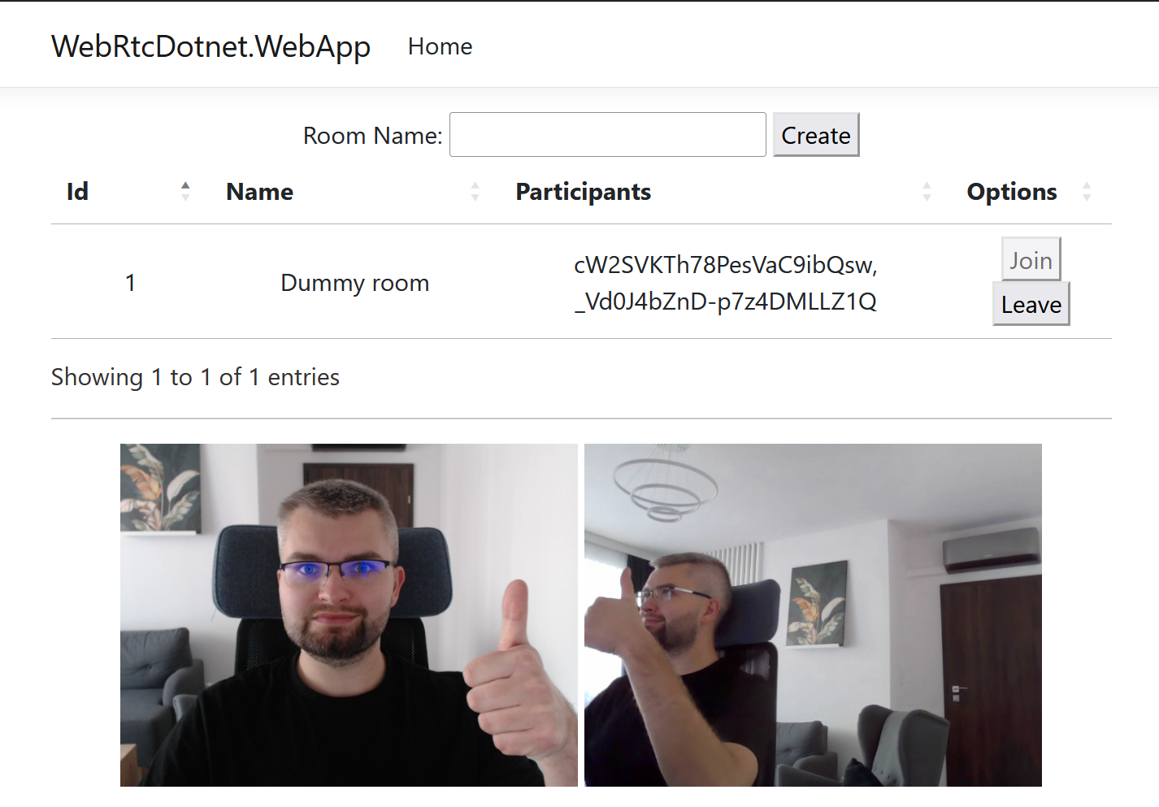
@lukaszpyrzyk / Sonova

Slide 33
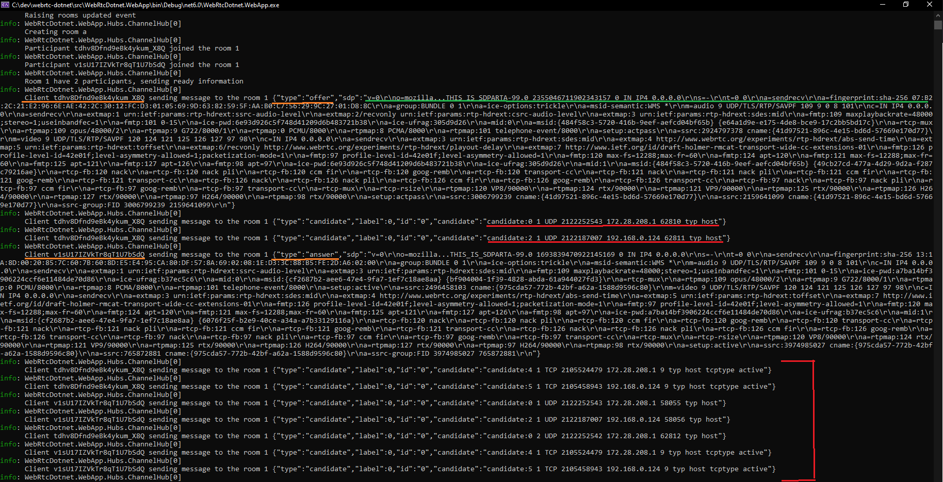
@lukaszpyrzyk / Sonova

Slide 34
@lukaszpyrzyk

Slide 35
Enterprise solutions
Writing raw WebRTC code and maintaining a dedicated Signaling is quite difficult. We have a lot of edge cases that need to be solved.
Because of that, on the market, few enterprise solutions offer plug & play experience for the developers. In most of the scenarios, a similar API is available for mobile/desktop/web ends and Signaling is based automatically by the provider.
If you want to find more, search for Twilio Voice/Video SDK, LiveSwitch SDK or Amazon Kinesis SDK.
@lukaszpyrzyk / Sonova

Slide 36
War story 1 – Same servers
Because of the legacy implementation of the previous audio-video call management, it was decided that both peers should use the same ICE servers.
ICE servers were selected based on the location of the one of participants. It sounded like a good idea to „have” both participants on the same servers, however…
ICE servers were hidden under the traffic manager, so we never knew if participants „are” on the same server
If one peer was available via srflx candidate, „having” participants on the same server doesn’t matter
For the worst-case scenario (TURN to TURN) it sounded like a potential optimization, however, we learned that it is much better to allow peers to connect to their closest ICE servers instead of forcing them to connect theoretically to the same machine.
Because of that, peers in the East US use TURN East, and peers in West US use TURN West. Due to network behaviors, it is much faster to connect two data centers with a fiber and their peers to the closest data center than force one user from the East on LTE to connect to the server on the West.
@lukaszpyrzyk / Sonova
Notes:
Te same

Slide 37
War story 2 – Better architecture
Because of the previous decision and official note from one of the Ice Provider Company we thought that all peers of the call need to use the same Ice Provider (same company).
With our R&D round, we confirmed that ICE, STUN and TURN are protocols that are not bounded to any specific ICE Provider and there is no technical requirement that forces using the same provider (company) on both ends.
We did a small experiment with a conference call that confirmed we can use different servers, from different companies to peer-relay-relay-peer connection.
Because of this discovery, we changed our design decision and loosen our architecture.
@lukaszpyrzyk / Sonova

Slide 38
War story 3 – DNS of the servers
Because of the legacy integration with one of the many ICE providers, our code was manually selecting the best data center of the Ice Provider.
For example, when discovered with app configuration that the peer is from Germany, we manually selected servers located in Germany, for example, de1.iceprovider.com.
After some time we added a second ICE provider and made it primary, so the previous one became a fallback. However, the region selection was reimplemented as well.
During our R&D round, we discovered that the new ICE Provider has an internal geo-specific load balancer located on global.iceprovider.org, so our manual mapping is:
Redundant, because each peer can manually resolve global.iceprovider.org to the closest data center (you can check it for example with nslookup command)
More accurate, because our location setting was set during the installation and it doesn’t exactly mean that user is still there
Better suited – ICE Provider knows better which data center should be selected. For example, even if the client is based in Germany and we have a German data center, it can be overloaded and the data center in France offers better performance.
@lukaszpyrzyk / Sonova

Slide 39



Other funny facts
WebTorrent client uses WebRTC as a transport later to send & receive files with P2P
The Peer5 CDN owned by Microsoft, use the client's bandwidth to upload media to other connected peers, enabling each peer to act as an edge server, without the need of geodestributed CDN.
Neither version of Internet Explorer supports WebRTC.
@lukaszpyrzyk / Sonova

Slide 40
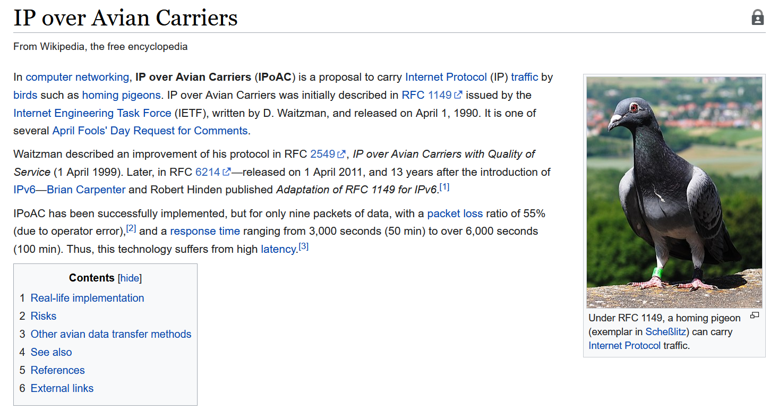
@lukaszpyrzyk / Sonova

Slide 41
Thanks!
Questions?
https://github.com/lukasz-pyrzyk/webrtc-dotnet
https://en.wikipedia.org/wiki/WebRTC
RFC5766, RFC5389, RFC5245, RFC5128
https://www.geeksforgeeks.org
Book „WebRTC For The Curious”
Feel free to reach out to me for more details.
Twitter: @lukaszpyrzyk LinkedIn: https://www.linkedin.com/in/lukaszpyrzyk/ Email: lukasz.pyrzyk@gmail.com
We look for more developers, https://www.sonova.com/en/jobs
@lukaszpyrzyk / Sonova

